Slide 1

AWARDS CEREMONY

Slide 2


INTERNATIONAL CONFERENCE ON INNOVATIVE PATHWAYS
IN EDUCATION AND MULTIDISCIPLINARY RESEARCH
AWARDS CEREMONY
Dr. Chanyanan Somthawinpongsai
Associate Dean
School of Liberal Arts
Shinawatra University, Thailand
Excellent Educator Award

Slide 3
INTERNATIONAL CONFERENCE ON INNOVATIVE PATHWAYS
IN EDUCATION AND MULTIDISCIPLINARY RESEARCH
AWARDS CEREMONY
Dr. R. Annadurai
Director
Centre for Educational Research
Madurai Kamaraj University
Madurai, Tamil Nadu, India
Excellent Academician Award

Slide 4
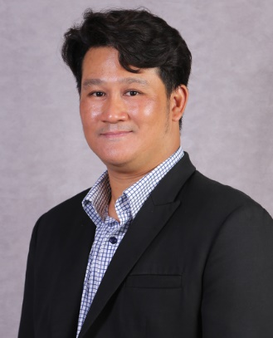
INTERNATIONAL CONFERENCE ON INNOVATIVE PATHWAYS
IN EDUCATION AND MULTIDISCIPLINARY RESEARCH
AWARDS CEREMONY
Dr. Sarana Photchanachan
Dean
Faculty of Management
Shinawatra University, Thailand
Excellent Academician Award

Slide 5
INTERNATIONAL CONFERENCE ON INNOVATIVE PATHWAYS
IN EDUCATION AND MULTIDISCIPLINARY RESEARCH
AWARDS CEREMONY
Dr. A. Veliappan
Head of the Department
Department of Education
Manonmaniam Sundaranar University
Tirunelveli, Tamilnadu, India
Excellent Academician Award

Slide 6
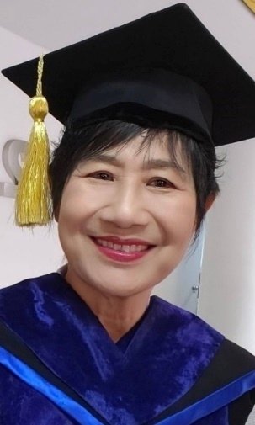
INTERNATIONAL CONFERENCE ON INNOVATIVE PATHWAYS
IN EDUCATION AND MULTIDISCIPLINARY RESEARCH
AWARDS CEREMONY
Dr. Jureerat Kijsomporn
Lecturer
Faculty of Nursing
Shinawatra University, Thailand
Outstanding Researcher Award

Slide 7
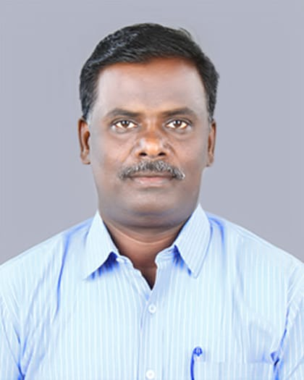
INTERNATIONAL CONFERENCE ON INNOVATIVE PATHWAYS
IN EDUCATION AND MULTIDISCIPLINARY RESEARCH
AWARDS CEREMONY
Dr. B. Kannan
Assistant Professor
Centre for Educational Research
Madurai Kamaraj University
Madurai, Tamil Nadu, India
Excellent Educator Award

Slide 8
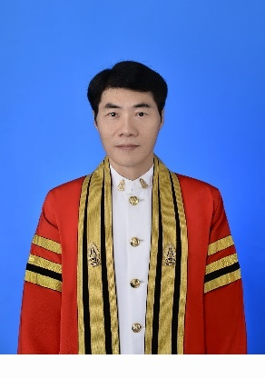
INTERNATIONAL CONFERENCE ON INNOVATIVE PATHWAYS
IN EDUCATION AND MULTIDISCIPLINARY RESEARCH
AWARDS CEREMONY
Dr. Pradit Songsangyos
Assistant Professor
Faculty of Engineering
Shinawatra University, Thailand
Outstanding Researcher Award

Slide 9
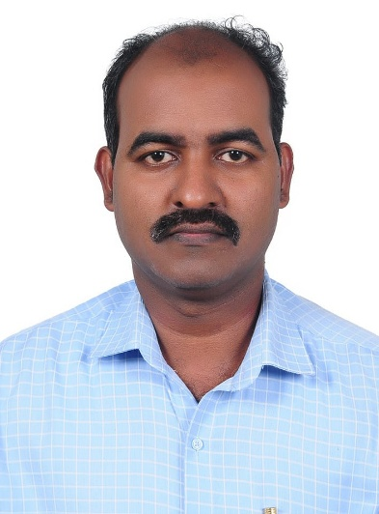
INTERNATIONAL CONFERENCE ON INNOVATIVE PATHWAYS
IN EDUCATION AND MULTIDISCIPLINARY RESEARCH
AWARDS CEREMONY
Dr. S. Lenin
Assistant Professor, Department of Education
Manonmaniam Sundaranar University
Tirunelveli, Tamil Nadu, India
Outstanding Researcher Award

Slide 10

INTERNATIONAL CONFERENCE ON INNOVATIVE PATHWAYS
IN EDUCATION AND MULTIDISCIPLINARY RESEARCH
AWARDS CEREMONY
Miss Waniga Kerdbang
Lecturer
Faculty of Liberal Arts
Shinawatra University, Thailand
Excellent Educator Award

Slide 11
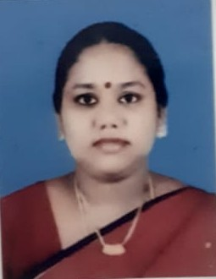
INTERNATIONAL CONFERENCE ON INNOVATIVE PATHWAYS
IN EDUCATION AND MULTIDISCIPLINARY RESEARCH
AWARDS CEREMONY
Ms. J. Monica Sheela
PG Assistant (Physics)
Christ King Girls Hr. Sec. School
Chennai, Tamil Nadu, India
Vibrant Teacher Award

Slide 12
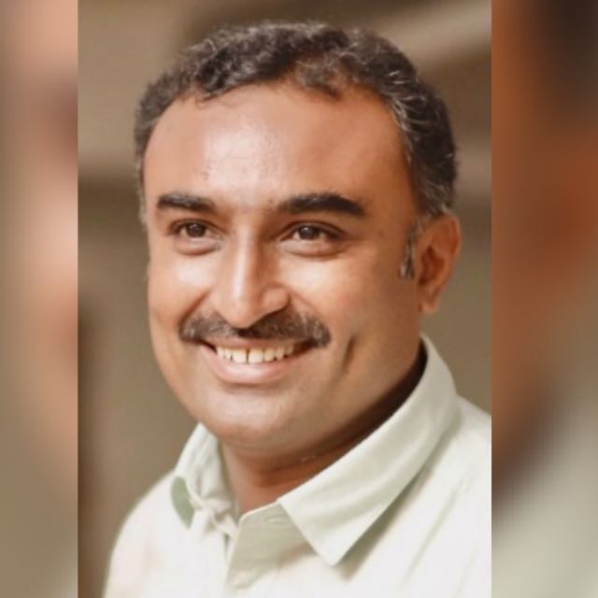
INTERNATIONAL CONFERENCE ON INNOVATIVE PATHWAYS
IN EDUCATION AND MULTIDISCIPLINARY RESEARCH
AWARDS CEREMONY
Dr. Suresh Prabhu
Principal
KSR College of Education
Namakkal, Tamil Nadu, India
Excellent Educator Award

Slide 13

INTERNATIONAL CONFERENCE ON INNOVATIVE PATHWAYS
IN EDUCATION AND MULTIDISCIPLINARY RESEARCH
AWARDS CEREMONY
Dr. Mesith Chaimanee
Dean
Mechanical Engineering and Technology
Shinawatra University, Thailand
Excellent Academician Award

Slide 14
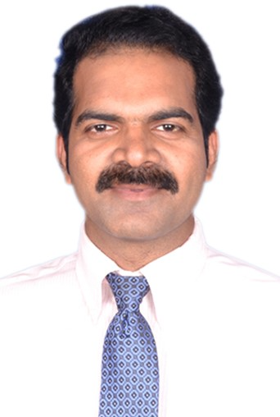
INTERNATIONAL CONFERENCE ON INNOVATIVE PATHWAYS
IN EDUCATION AND MULTIDISCIPLINARY RESEARCH
AWARDS CEREMONY
Dr. Kotra Balayogi
Vice Principal
Department of Teacher Education
Unity College of Teacher Education
Nagaland, India
Excellent Educator Award

Slide 15

INTERNATIONAL CONFERENCE ON INNOVATIVE PATHWAYS
IN EDUCATION AND MULTIDISCIPLINARY RESEARCH
AWARDS CEREMONY
Dr. Kasinee Sokhuma
Lecturer
Faculty of Education
Shinawatra University, Thailand
Excellent Educator Award

Slide 16
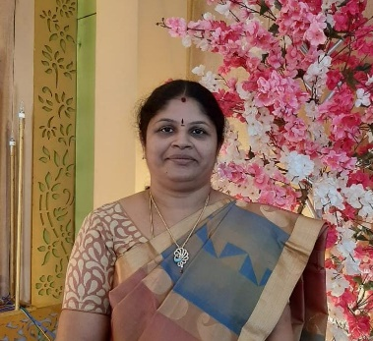
INTERNATIONAL CONFERENCE ON INNOVATIVE PATHWAYS
IN EDUCATION AND MULTIDISCIPLINARY RESEARCH
AWARDS CEREMONY
Dr. T. Malliga
Principal
Vellalar College of Education
Erode, Tamil Nadu, India
Excellent Educator Award

Slide 17
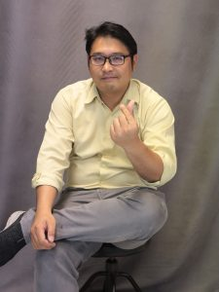
INTERNATIONAL CONFERENCE ON INNOVATIVE PATHWAYS
IN EDUCATION AND MULTIDISCIPLINARY RESEARCH
AWARDS CEREMONY
Mr. Thanit Limpabandhu
Program Chair of Art & Design Program
Faculty of Liberal Arts
Shinawatra University, Thailand
Excellent Academician Award

Slide 18
INTERNATIONAL CONFERENCE ON INNOVATIVE PATHWAYS
IN EDUCATION AND MULTIDISCIPLINARY RESEARCH
AWARDS CEREMONY
Dr. M. Panneerselvam
Principal
Senthil College of Education
Vriddhachalam, Tamil Nadu, India
Excellent Educator Award

Slide 19
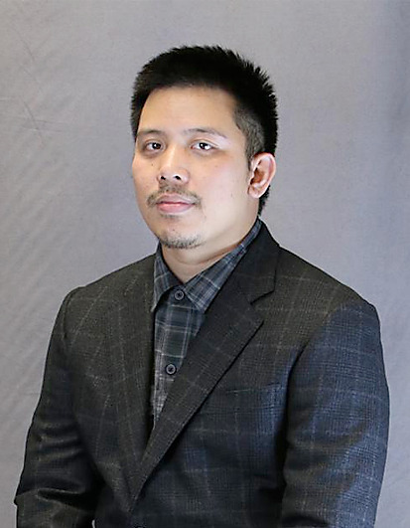
INTERNATIONAL CONFERENCE ON INNOVATIVE PATHWAYS
IN EDUCATION AND MULTIDISCIPLINARY RESEARCH
AWARDS CEREMONY
Mr. Thammasin Darunkan
Lecturer in the Product Design Program
Faculty of Liberal Arts
Shinawatra University, Thailand
Young Researcher Award

Slide 20
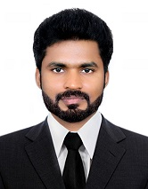
INTERNATIONAL CONFERENCE ON INNOVATIVE PATHWAYS
IN EDUCATION AND MULTIDISCIPLINARY RESEARCH
AWARDS CEREMONY
Dr. Parthiban G
Principal
Sri K. Ramachandra Naidu College of Education
Sankarankovil, Tamil Nadu, India
Outstanding Researcher Award

Slide 21
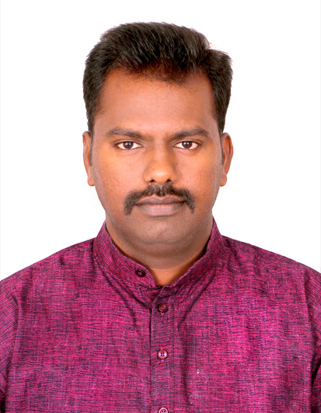
INTERNATIONAL CONFERENCE ON INNOVATIVE PATHWAYS
IN EDUCATION AND MULTIDISCIPLINARY RESEARCH
AWARDS CEREMONY
Dr. P. Sivaguru
Guest Teacher
Gandhian Thought and Peace Science
GRI University, Tamil Nadu, India
Young Researcher Award

Slide 22
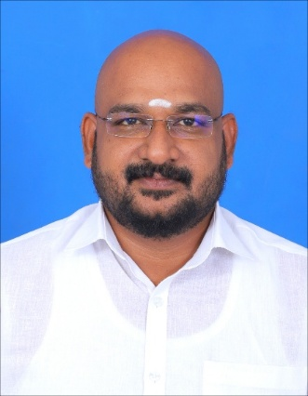
INTERNATIONAL CONFERENCE ON INNOVATIVE PATHWAYS
IN EDUCATION AND MULTIDISCIPLINARY RESEARCH
AWARDS CEREMONY
Dr. ARS. Kannan
Principal
Sri Jayajothi College of Education
Salem, Tamil Nadu, India
Excellent Academician Award

Slide 23

INTERNATIONAL CONFERENCE ON INNOVATIVE PATHWAYS
IN EDUCATION AND MULTIDISCIPLINARY RESEARCH
AWARDS CEREMONY
Miss Rungnapa Sathittham
Lecturer
Faculty of Liberal Arts
Shinawatra University, Thailand
Young Researcher Award

Slide 24
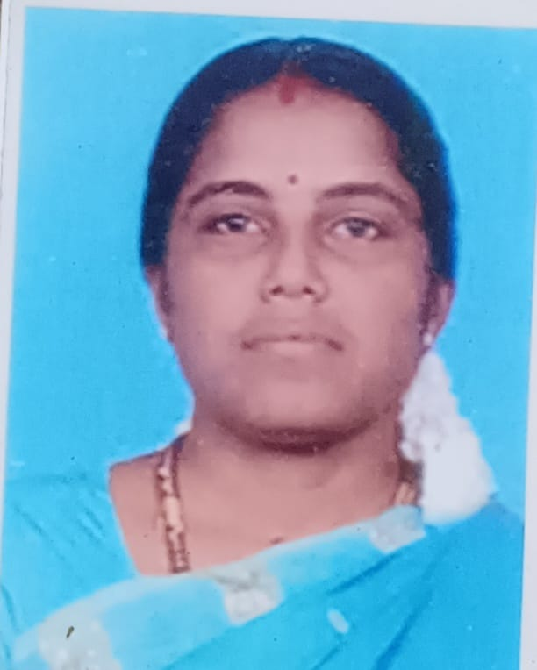
INTERNATIONAL CONFERENCE ON INNOVATIVE PATHWAYS
IN EDUCATION AND MULTIDISCIPLINARY RESEARCH
AWARDS CEREMONY
Dr. Meenatchi K
Senior Lecturer & HOD
District institute of Education and Training
Pudukkottai, Tamil Nadu, India
Excellent Academician Award

Slide 25
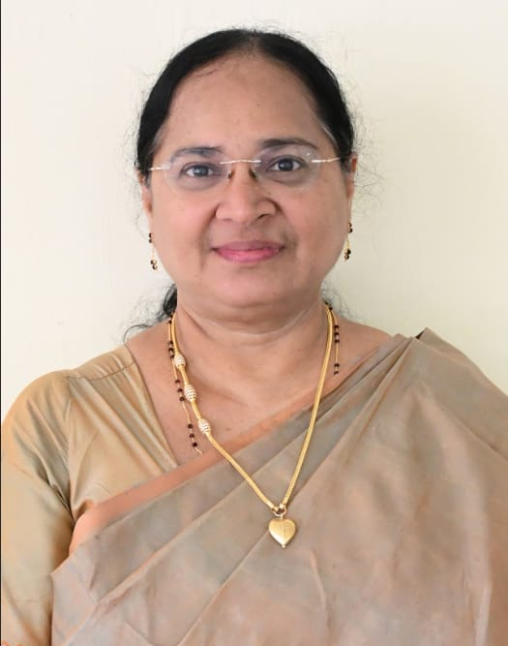
INTERNATIONAL CONFERENCE ON INNOVATIVE PATHWAYS
IN EDUCATION AND MULTIDISCIPLINARY RESEARCH
AWARDS CEREMONY
Dr. Helen Mary Jacqueline M
Associate Professor and Dean of Academic Affairs
Department of Economic, Lady Doak College
Madurai, Tamil Nadu, India
Outstanding Researcher Award

Slide 26
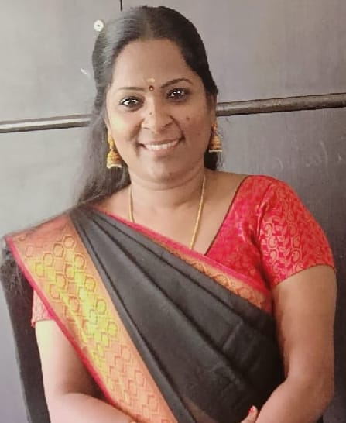
INTERNATIONAL CONFERENCE ON INNOVATIVE PATHWAYS
IN EDUCATION AND MULTIDISCIPLINARY RESEARCH
AWARDS CEREMONY
Dr. R. Sutha
Head of the Department
Department of Mathematics
St. Joseph's Arts and Science College for women
Singampunari, Tamilnadu, India
Excellent Educator Award

Slide 27
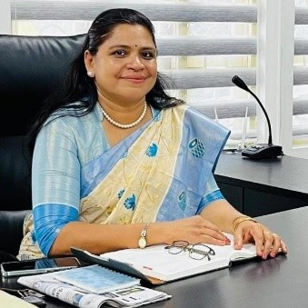
INTERNATIONAL CONFERENCE ON INNOVATIVE PATHWAYS
IN EDUCATION AND MULTIDISCIPLINARY RESEARCH
AWARDS CEREMONY
Ms. Ajeena AP
Principal
Navy Children School
Kochi, Kerala, India
Excellent Educator Award

Slide 28
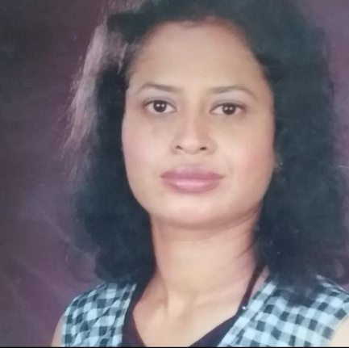
INTERNATIONAL CONFERENCE ON INNOVATIVE PATHWAYS
IN EDUCATION AND MULTIDISCIPLINARY RESEARCH
AWARDS CEREMONY
Ms. Prajakta Sharad Raut
Assistant Professor & Head
Department of English
Abhinav Degree College
Maharashtra, India
Vibrant Teacher Award

Slide 29
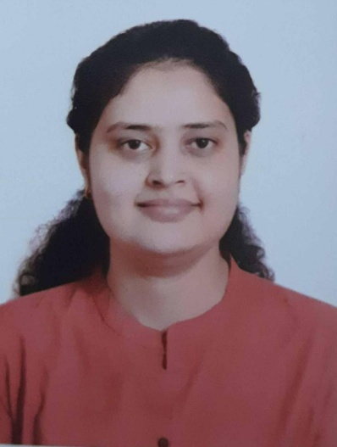
INTERNATIONAL CONFERENCE ON INNOVATIVE PATHWAYS
IN EDUCATION AND MULTIDISCIPLINARY RESEARCH
AWARDS CEREMONY
Ms. Divya Mishra
Ph.D. Scholar
Department of Educational Studies
Jamia Millia Islamia, New Delhi, India
Outstanding Researcher Award

Slide 30
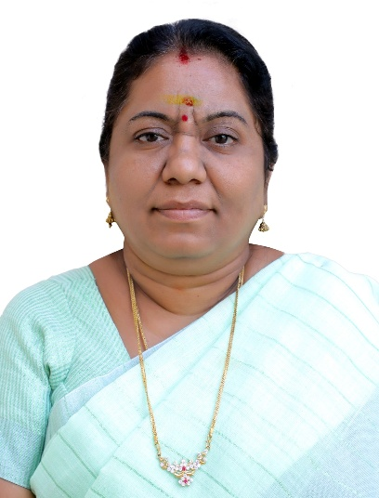
INTERNATIONAL CONFERENCE ON INNOVATIVE PATHWAYS
IN EDUCATION AND MULTIDISCIPLINARY RESEARCH
AWARDS CEREMONY
Dr. P. Shanthy
Principal
M. Kumarasamy College of Education
Karur, Tamilnadu, India
Excellent Educator Award

Slide 31
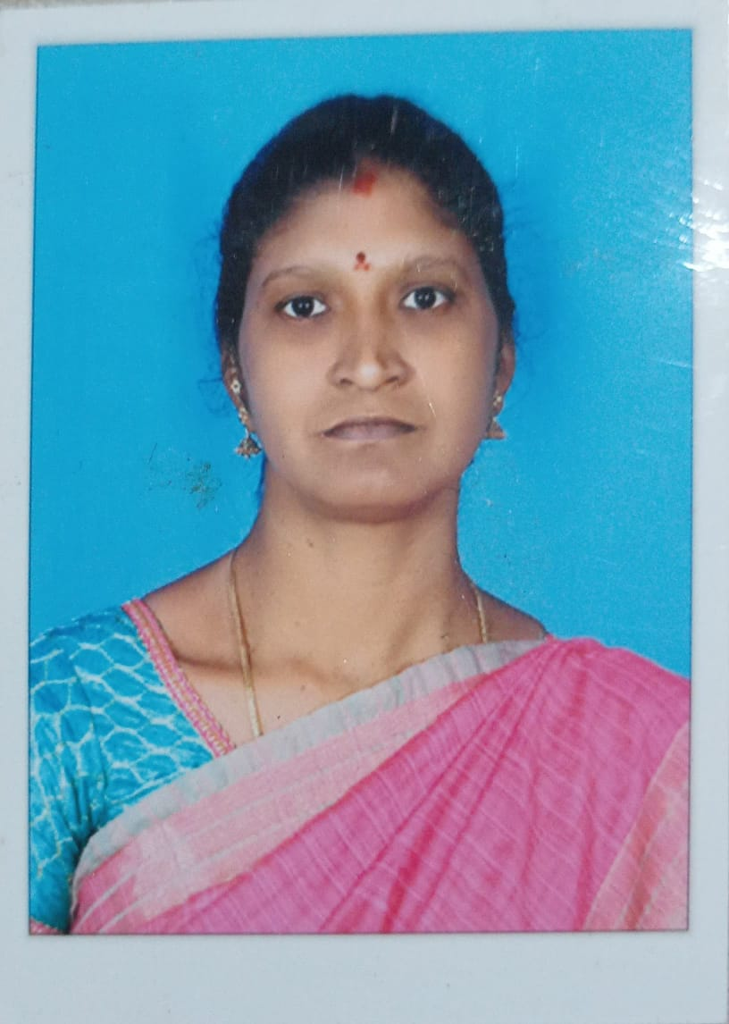
INTERNATIONAL CONFERENCE ON INNOVATIVE PATHWAYS
IN EDUCATION AND MULTIDISCIPLINARY RESEARCH
AWARDS CEREMONY
Dr. S. Brindha
Assistant Professor
Department of Tamil
Ganesar College of Arts & Science
Pudukkottai, Tamil Nadu, India
Vibrant Teacher Award

Slide 32
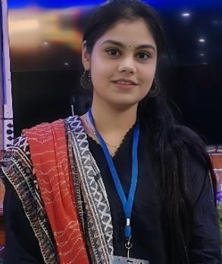
INTERNATIONAL CONFERENCE ON INNOVATIVE PATHWAYS
IN EDUCATION AND MULTIDISCIPLINARY RESEARCH
AWARDS CEREMONY
Ms. Anam Zehra
Research Scholar
Department of Educational Studies
Jamia Millia Islamia, New Delhi
Outstanding Researcher Award

Slide 33
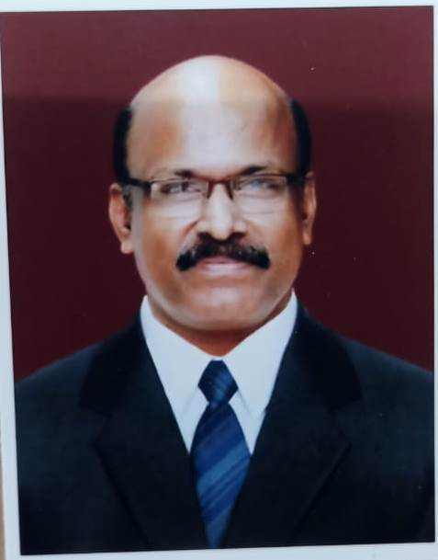
INTERNATIONAL CONFERENCE ON INNOVATIVE PATHWAYS
IN EDUCATION AND MULTIDISCIPLINARY RESEARCH
AWARDS CEREMONY
Dr. Ramasamy
Principal
Dr. N.G.P. College of Education
Coimbatore, Tamil Nadu, India
Lifetime Achievement Award

